Slide 1

Market Segmentation Using K-Means Clustering Analysis
Cincinnati Raptors
Team Members:
Sudhir Vedula
Romil Shah
Hardik Patel
Nikit Choksi
Shiv Patel

Slide 2

Table of Content
Software(s) Used: Alteryx Designer and Tableau Public
Table of Content:
Business Use Case
Aim
Dataset Introduction
Tools for Data Analysis and Visualization
Software Details
What is Alteryx Designer?
Why have we used Alteryx Designer?
Processes involved in implementing Alteryx Designer (Data Analysis)
What is Tableau Public?
Why have we used Tableau Public?
Processes involved in implementing Tableau Public (Data Visualization)
Key Alternatives
Discussion of Recommendation
Future developments of the software and software category of BI&A software
Demo of the Tools
Thank You

Slide 3
Business Use Case
ABC Beer Company is trying to improve its sales revenue model
ABC Beer Company has consulted Cincinnati Raptors for getting a solution to their business case scenario of improving its sales model
We aim to perform Market Segmentation incorporating predictive analytics & K-Means clustering, based on the qualitative values ie. IBU(International Bitterness Units) and ABV(Alcohol by volume) of each beer
Beer segmentation is correlated to segmentation of breweries as well, since we have associated data of specialty of beer at each brewery

Slide 4
Aim
To perform Market Segmentation for ABC Beer Company using predictive analytics method of K-Means clustering
Based on the qualitative values of each beer we have placed them into one of 4 different buckets or categories
Categorization of beers enables the Marketing & Sales team of the Beer Company to target specific customers

Slide 5
Dataset Introduction
The source of data is https://openbeerdb.com/
Beer.xlsx
Records: 5901
Columns: id,brewery_id,name,cat_id,style_id,abv,ibu,srm,upc,filepath,add_user,last_mod
Breweries.xlsx
Records: 1414
Columns: id,name,address1,address2,city,state,code,country,phone,website,filepath,add_user,last_mod
styles.xlsx
Records: 141
Columns: id,cat_id,style_name,last_mod
geocodes.xlsx
Records-1304
Columns: id,brewery_id,latitude,longitude,accuracy

Slide 6
Tools for Data Analysis and Visualization
Alteryx Designer
Data Analysis
Data Manipulation
Performs ETL Processes
Tableau Public
Data Visualization
Uses the transformed dataset obtained from the Alteryx Designer

Slide 7
Software Details
What is Alteryx Designer?
A solution that accelerates the process of data preparation, blending and analysis
Streamlines predictive, statistical and spatial analysis with the help of repeatable workflows
Allows creation and sharing of insights in hours instead of weeks
Both a code-free and code-friendly interface
Provides accessibility to self-service BI, irrespective of skill levels
Why have we used Alteryx Designer?
To achieve K Means Clustering Analysis of classifying beers into 4 different clusters
Uses different functionalities to perform the ETL processes
Generates an output file K_Means_Analysis.xlsx file which has all the required columns for visualizing the data, it does a messy job of providing the clustering analysis report

Slide 8
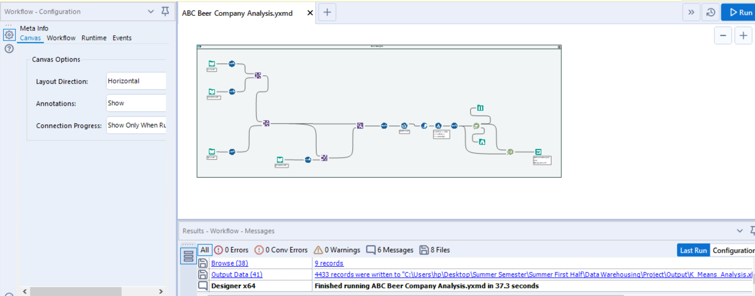
Processes involved in implementing Alteryx Designer (Data Analysis)
Software Details
Figure 1: Alteryx Workflow to implement ETL Processes for ABC Beer Company
Notes:
The details have been explained in the Tutorial, however, here is an overview of the steps and processes involved in implementing Alteryx Designer.
Four datasets provided by the ABC Beer Company to Raptors are extracted
It is interpreted by the Alteryx Designer using the Input Tool and relevant columns for analysis are selected using the Select Tool
The columns which are not necessary for the data analysis will not be processed any further
The data manipulation is done using the Join Tool and Find and Replace Tool to join the 4 datasets
Filter tool is used to filter out the records which have an abv=0(qualitative value)
It automatically performs the K means clustering using the K -Centroids Cluster Analysis Tool

Slide 9
What is Tableau Public?
Software Details
It is a free software that can allow anyone to connect to a spreadsheet or a file and create interactive data visualizations for the web
Why have we used Tableau Public?
To implement visualizing and feeding the dataset obtained from the Alteryx Designer
Alteryx does not do a good job at visualizing data
To build 2 worksheets and a dashboard for visualizing data
Contents can be published online for users to see the visual representation of the Analysis

Slide 10
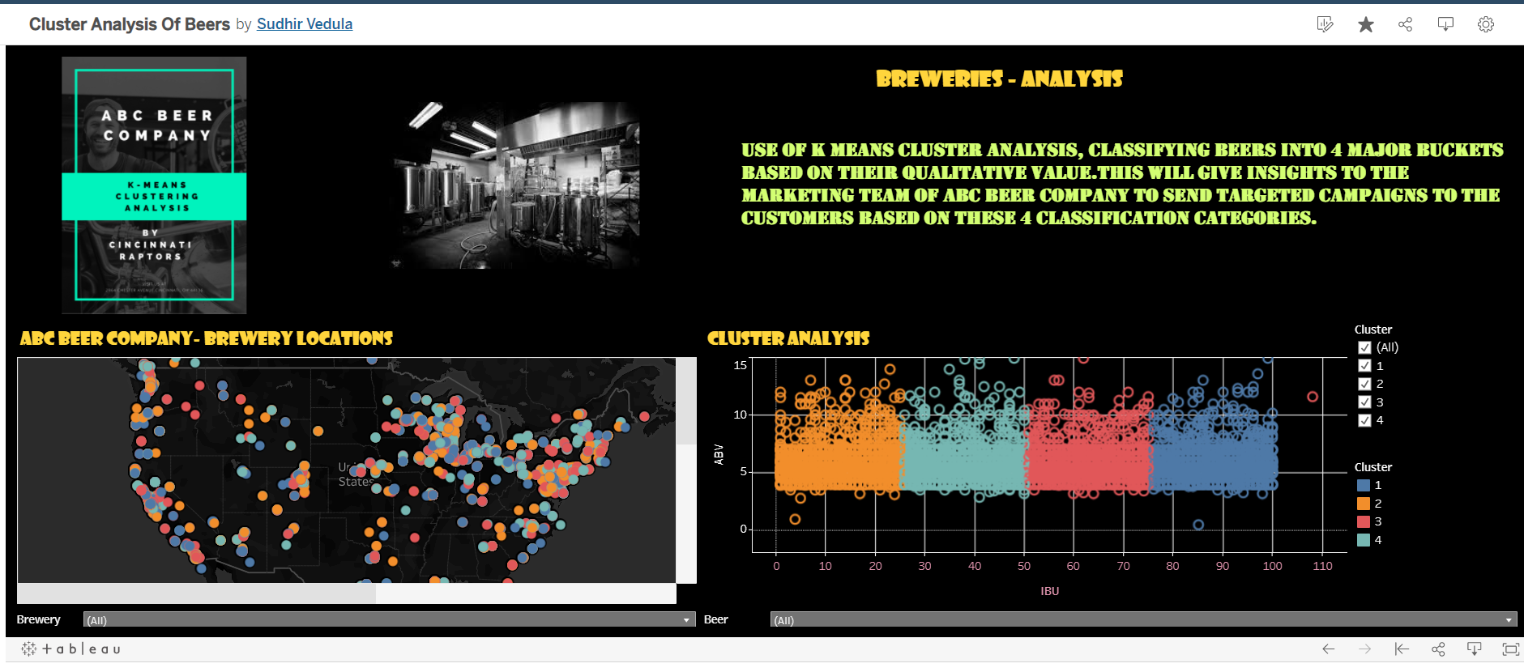
Processes involved in implementing Tableau Public(Data Visualization)
Software Details
Figure 2: Tableau Public to implement Data Visualization for Market Segmentation
Notes:
A brief explanation of the processes involved in implementing the Tableau Public tool to perform our data analysis:
1.ABC Beer Company-Brewery Locations Worksheet
This worksheet will provide the brewery locations and the beer specialty served at the breweries of ABC Beer Company across the world.
We will be using the Longitude Dimension(obtained from the geocode.xlsx file) on the Columns section and
Latitude Dimension(obtained from the geocode.xlsx file)on the Rows section to plot the visual location of each brewery on the world map.
The details of brewery name, beer name specialty, location and cluster details will be provided on highlighting a specific point of place.
2.Cluster Analysis Worksheet- This worksheet will provide the details of each beer and brewery which have been clustered into a specific bucket of the
4 clusters that we had formed.
We will be using IBU(International Bitterness Units) measure in the columns section and ABV(Alcohol by volume) measure in the rows measure
to depict the cluster information of each brewery and beer name specialty type.
The details of brewery name, beer name specialty, location and cluster details will be provided on highlighting a specific point.
3.Breweries Analysis-Dashboard visualizing the 2 individual worksheets that were created using Tableau Public which would give the
larger picture to the end user.
4. Additionally we have provided the filters on Brewery Name, Beer Name and Cluster Name which are hierarchical in nature
to give the end user a general trend of the identifying a brewery and specialty of beer associated with a particular cluster.

Slide 11
Key Alternatives
Some of the Key Alternatives for Alteryx Designer in the broad category of data preparation, data blending and advanced analytics are SAS, SAP Advanced Analytics, Salesforce, Microsoft, IBM, Oracle, Teradata and Informatica.
Key Alternatives for Tableau Public in the broad category of data visualization are Microsoft Power BI, QlikView, SAP Advanced Analytics & Tableau.

Slide 12
Discussion of Recommendation
Overall specific to our Business Use Case, we recommend the use of Alteryx Designer And Tableau Public
Strengths
Challenges
It saves a lot of time as we don't need to write pages of code using a statistical language like R/Python to implement K Means Clustering
Identification of error is easily achieved along with the quick creation of data flow and workflow
Tableau Public simplifies the analysis of data which would provide the customer a storytelling model
Helps to do visual analytics, discover new insights and engage others
Tableau can handle millions of rows of data with ease with an option to show live data with connections to different data sources
Depending on the business scenario, the workflows could be complex to build especially while incorporating macros
Not favorable to use when multiple users try to access the same workflow on a server as it becomes unstable and frequently crashes
Tableau focuses primarily on visualization and cannot work perfectly with uncleaned data
In order to efficiently use Tableau, proper data cleansing is needed in the underlying database first
Automatic option to refresh reports is not provided with the help of scheduling

Slide 13

Discussion of Recommendations
We have placed similar beers & breweries based on their qualitative values into 4 different categories using Market Segmentation Analytical Techniques
Beers classified in different clusters have similar qualitative values
Customers can be targeted by sending out focused email advertising campaigns
We recommend the Marketing & Sales team of ABC Beer Company to target customers by employing focused advertising campaigns
The type of customers to be targeted are:
Frequent visitors of a brewery who prefer a certain specialty of beer to try other beers and breweries placed within the same Cluster
There is a high probability of a customer liking a beer having a similar qualitative value, thus driving ABC Beer Company’s overall sales revenue

Slide 14
Future developments of the software and software category of BI&A software
Alteryx Designer and Tableau have stepped into intuitive, cloud native data preparation, blending, analytical solutions and data visualization that is accessible to anyone in the enterprise who interacts with data. There is also a strong focus on Cloud Computing and Artificial Intelligence.
Other softwares in this category are also increasingly investing in Augmenting AI for intelligent data ingestion and processing.
Other softwares in this category are also increasing their focus on Real Time Data Vizualization & augmented virtual reality.

Slide 15

Demo of The Tools
Link : https://ucincinnati.webex.com/webappng/sites/ucincinnati/recording/69661c09aede10399fa10050568f2060/playback

Slide 16


